Slide 1




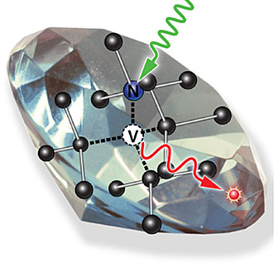
NV Centre Diamond Magnetic Sensors

Slide 2
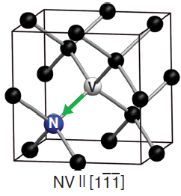
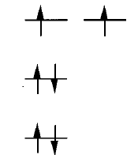
What Is NV Centre ?
Substitutional nitrogen atom adjacent to a carbon vacancy in crystal diamond lattice.
The 3 carbon atoms adjacent to the vacancy have only 3 bonds with other carbon atoms.
So each of the 3 carbon atoms adjacent to the vacancy have 1 highly unstable dangling electron.
The nitrogen atom has 1 lone pair of electrons.
NV⁰ centre traps 1 extra e- from the nearby electron donor (another N impurity) to become NV⁻ centre with 6e-.
The green arrow marks the NV symmetry axis.
It acts as a two hole system where the 2 e- from the lone pair decide the spin triplet or singlet.
C
C
C
Diamond lattice containing an NV centre
[John F. Barry et al, Rev. Mod. Phys., 0034-6861/2020/92(1)/015004(68)]
e_{x}
e_{y}
v
u
Ground state spin configuration of 6e- NV centre
[A. Lenef et. al. Physical Review B, Volume 53(20), 0163-1829/96/53(20)/13441(15)]

Slide 3
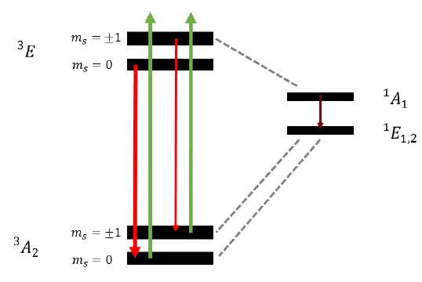
Nitrogen Vacancy Energy Level
Green Laser Pump
Green light (532 nm) excites electrons from ground state triplet ³A to excited state triplet ³E
e⁻ with m_{s} = 0 drop straight back down via radiative path emitting bright red fluorescence.
Most of the e⁻ with m_{s} = +/-1 divert sideways non-radiatively via intersystem crossing into a singlet shelving state ¹A₁
Then from ¹A₁ it decays to another singlet state ¹E_{1,2} emitting infra-red (1042 nm).
And finally from ¹E_{1,2} it decays non-radiatively to m_{s} = 0 and m_{s} = +/-1 ground state level with equal probabilities.
Continuous green light automatically polarizes almost all spins into the bright m_{s} = 0 starting state.
Excitation = always spin conserving
Decay = sometimes spin conserving
D_{e}
IR
D_{g}
Energy level diagram for NV− center in diamond
Ground state zero field splitting energy, D_{g} = 2.87 GHz
m_{s} = electron spin projection quantum number
Excited state zero field splitting energy, D_{e} = 1.41 GHz
Rosenzweig, Yossi. (2016). The Physics of Nitrogen-Vacancy Color Centers in Diamonds and their Interaction with External Fields.

Slide 4
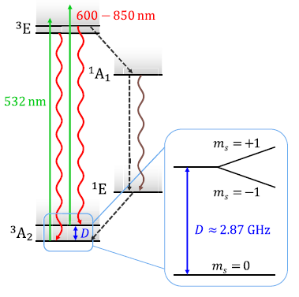
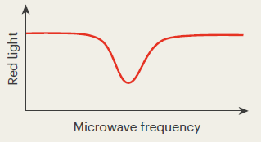
Nitrogen Vacancy Energy Level
Microwave Signal
An onboard MW antenna broadcasts and sweeps microwave frequency around 2.87 GHz.
When the MW frequency matches the ground state energy gap, it flips spins from m_{s} = 0 to m_{s} = +/-1
Diverted spins take the singlet shelved dark path causing a dip in the red light intensity.
IR
D
Dip in the red fluorescence at spin flipping frequency
Energy level diagram for NV− center in diamond
[N. Savage, Nature, Vol 591, doi.org/10.1038/d41586-021-00743-3]
[John F. Barry et al. , Rev. Mod. Phys., Vol 92, 0034-6861/2020/92(1)/015004(68)]

Slide 5
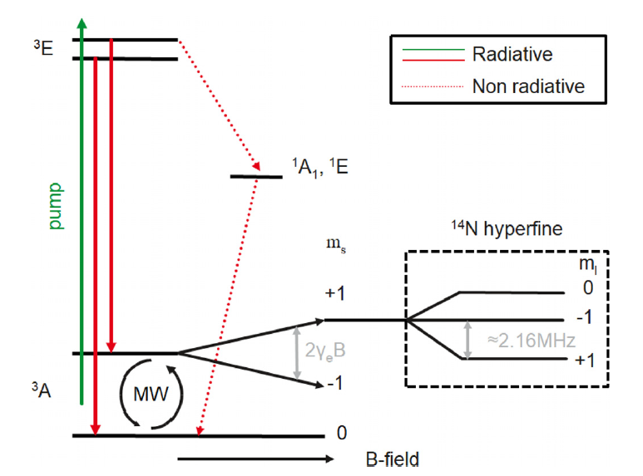
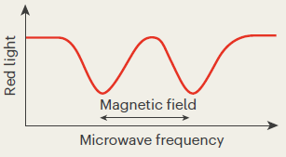

Nitrogen Vacancy Energy Level
ODMR
External low frequency magnetic field (B_{z}) is applied along the NV axis.
Zeeman shift: MF induces an energy shift in the ground triplet state for m_{s} = +/-1
Fluorescence dips occur at two distinct frequencies.
The separation between these two dips directly related to the magnetic field strength.
γ_{e} = gyromagnetic ratio (28 Hz/nT)
D
2γ_{e}B
Energy level diagram for NV− center in diamond
[James L. Webb et. al., Appl. Phys. Lett. 114, 231103 (2019); doi: 10.1063/1.5095241]
Dip in the red fluorescence at spin flipping frequencies
Zero field splitting energy (D = 2.87 GHz)
[N. Savage, Nature, Vol 591, doi.org/10.1038/d41586-021-00743-3]

Slide 6
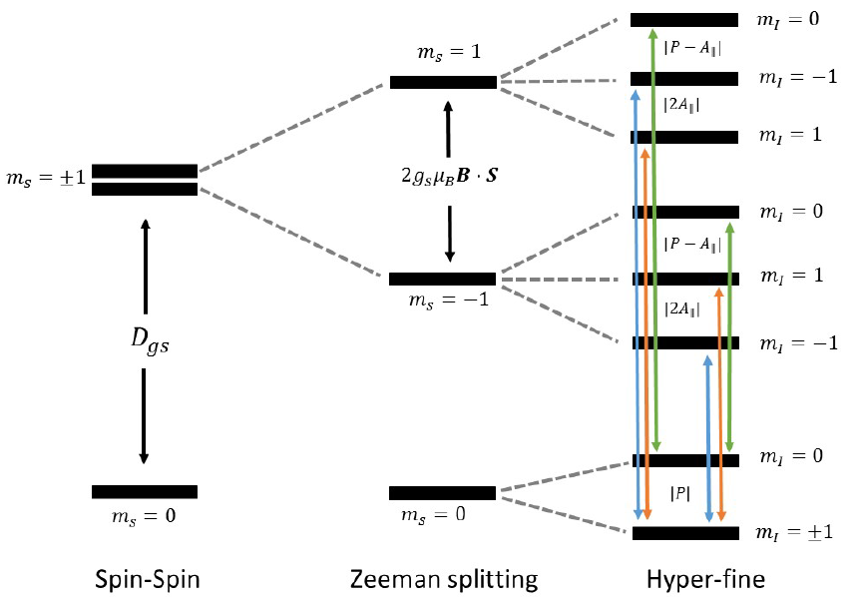
Nitrogen Vacancy Energy Level
¹⁴N hyperfine structure
Electron spin (S=1) couples with nuclear spin of adjacent N-14 atom (I=1)
3 fold splitting in each of the Zeeman levels forming a 9-state system.
Each of the two main magnetic dips further split into three closely spaced mini dips.
The green line shows transition from (m_{s} = 0; m_{i} = 0) to (m_{s} = +/-1; m_{i} = 0).
The orange and blue lines show similar transition but with m_{i} = +1 and m_{i} = -1 respectively.
2γ_{e}B
D = 2.87 GHz
P = -4.95 MHz
A_{II} = -2.16 MHz
Ground state energy levels and allowed transitions in NV- centre
Rosenzweig, Yossi. (2016). The Physics of Nitrogen-Vacancy Color Centers in Diamonds and their Interaction with External Fields.

Slide 7
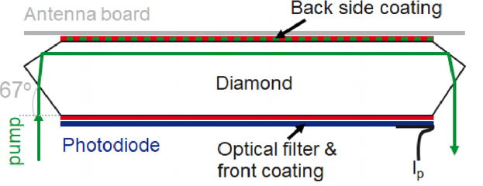
Optical and crystal design
Special Diamond Cuts
67° Cut (Brewster Angle):
minimizes reflection loss.
ensures maximum transmission of green laser pump.
22.7° Cut:
directs the laser beam laterally across the width of the crystal.
excites maximum number of NV centres.
Optical Coating and Filtering
Coatings:
Back side facing the MW antenna is layered with highly reflective (R>99%) for wavelength 500-800 nm.
Front side has split coating. It is highly reflective (R>99%) for 532 nm green light but anti-reflective (R<1%) for 600-800nm red fluorescence.
Filtering and Detection: Optical long pass filter (550 nm) rejects stray green light so that photodiode can measure red fluorescence effectively.
22.7°
Schematic of the specially cut diamond crystal
James L. Webb et. al., Appl. Phys. Lett. 114, 231103 (2019); doi: 10.1063/1.5095241

Slide 8
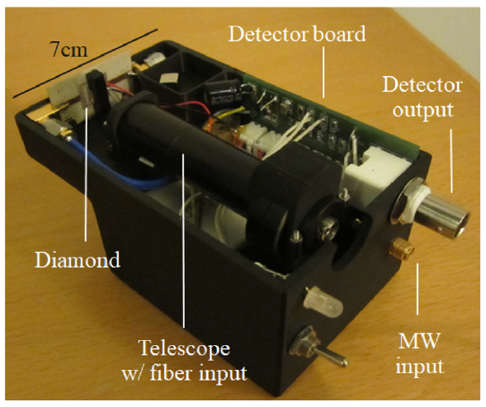
Optical and crystal design
Back side
Front side
Handheld NV diamond magnetometer
James L. Webb et. al., Appl. Phys. Lett. 114, 231103 (2019); doi: 10.1063/1.5095241

Slide 9
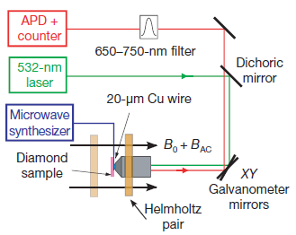
Electronic Spin Echo Measurement
Confocal Microscopy setup
J.R. Maze et. al., Nanoscale Magnetic Sensing in diamond, Nature-Vol 455 | 2 October 2008 | doi:10.1038/nature07279

Slide 10
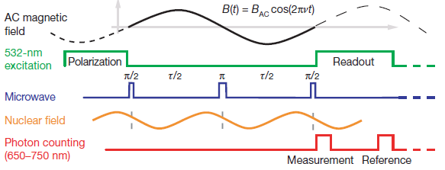

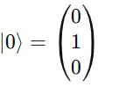
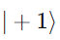
Electronic Spin Echo Measurement
AC Magnetic Field Sensing
Spin Echo: Recovery of the signal with spin information.
Spin Echo Interval:
Total free evolution time during which the NV spin accumulates phase from AC magnetic field.
Time difference between the two π/2 pulses.
Polarization (1us): A green laser pulse polarizes the spin into m_{s} = 0 ground state.
π/2 pulse: MW pulse creates coherent superposition of m_{s} = 0 and m_{s} = 1 states.
Free Evolution (τ/2): The NV spin accumulates phase under AC magnetic field and ¹³C nuclear spins.
π refocusing pulse: Swaps the spin ( to ) to cancel the static noise.
τ = 1/ ν
Optical and microwave spin echo
pulse sequence
J.R. Maze et. al., Nanoscale Magnetic Sensing in diamond, Nature-Vol 455 | 2 October 2008 | doi:10.1038/nature07279

Slide 11
Electronic Spin Echo Measurement
AC Magnetic Field Sensing
Free Evolution (τ/2):
Phase accumulated here gets added to the phase from the first half as the field is oscillating.
But the phase due to static noise gets cancelled.
π/2 readout pulse: The accumulated phase is converted into a population difference.
Readout (3us):
The number of photons is counted during the measurement window.
The measured fluorescence is dependent to the probability of NV spin in m_{s}=0 state which is inturn dependent on the accumulated phase.
τ = 1/ ν
Optical and microwave spin echo
pulse sequence
J.R. Maze et. al., Nanoscale Magnetic Sensing in diamond, Nature-Vol 455 | 2 October 2008 | doi:10.1038/nature07279

Slide 12
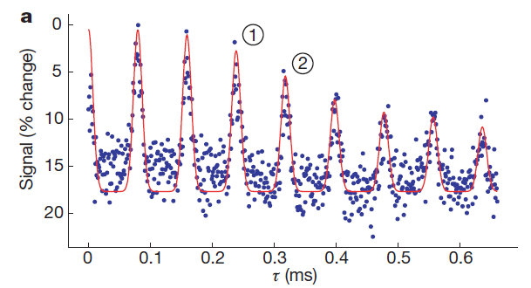
Electronic Spin Echo Measurement
Peaks and Valleys
Normalized spin echo signal (corresponding to fractional change in NV centre fluorescence) over time.
Oscillating peaks and valleys are caused by the NV spin interacting with surrounding bath of ¹³C nuclear spins.
Peaks = Revivals
Valleys = Collapses
Revivals occur periodically at half the rate of the Larmor frequency of the ¹³C nuclei.
Experiments are conducted at the revival peaks as the NV spin decouples from the magnetic noise of ¹³C nuclei.
Electronic Spin Echo measurement
over time
J.R. Maze et. al., Nanoscale Magnetic Sensing in diamond, Nature-Vol 455 | 2 October 2008 | doi:10.1038/nature07279

Slide 13
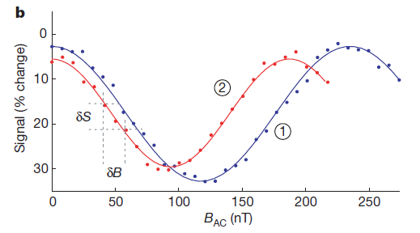
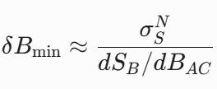


Electronic Spin Echo Measurement
Sensitivity of magnetometer
Normalized spin echo signal as a function of amplitude of external AC magnetic field.
With increasing field amplitude, NV spin accumulates phase due to time varying Zeeman shift.
The phase accumulation is read out as a periodic change in the detected fluorescence.
Magnetometer is most sensitive at the point of maximum slope (small change in magnetic field).
Sensitivity is limited by uncertainty in measurement of spin echo signal (noise).
Cosine behaviour of signal can be changes to a sine behaviour by adjusting the phase of microwave signal by 90°.
f₂ = 4.21 kHz
f₁ = 3.15 kHz
Electronic Spin Echo measurement with
external AC magnetic field
Sensitivity:
: noise
: slope
J.R. Maze et. al., Nature-Vol 455 | 2 October 2008 | doi:10.1038/nature07279

Slide 14
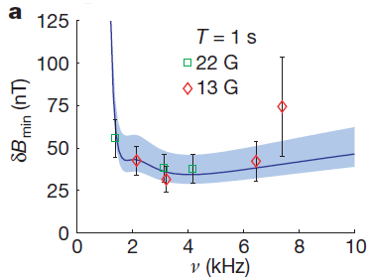
Sensitivity V/S AC Frequency
Results
Input Parameters:
AC magnetic field frequency ranging from 1-10 kHz.
Measurements are taken at two different static magnetic fields B₀ = 13 G and B₀ = 22 G
Averaging time is T = 1s
Output: Minimum detectable AC magnetic field
Observations:
Sensitivity is lowest at around 3 kHz.
The minimum detectable field is about 30 nT.
At low frequencies, the sensitivity is very poor as the spin echo interval becomes very long and NV spin decoheres before echo is formed.
Minimum detectable AC field over a range of frequencies
N. Savage, Nature, Vol 591, doi.org/10.1038/d41586-021-00743-3

Slide 15
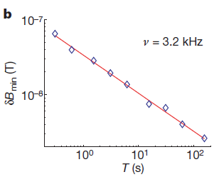


Sensitivity V/S Averaging Time
Results
Input Parameters: AC magnetic field at ν = 3.2 kHz and B₀ = 13G.
Output: Minimum detectable AC magnetic field on logarithmic scale.
Observations:
Sensitivity improves with averaging time.
After 100s of averaging, magnetic fields as small as few nanoteslas are resolvable.
Minimum detectable AC field as a function of averaging time
N. Savage, Nature, Vol 591, doi.org/10.1038/d41586-021-00743-3

Slide 16
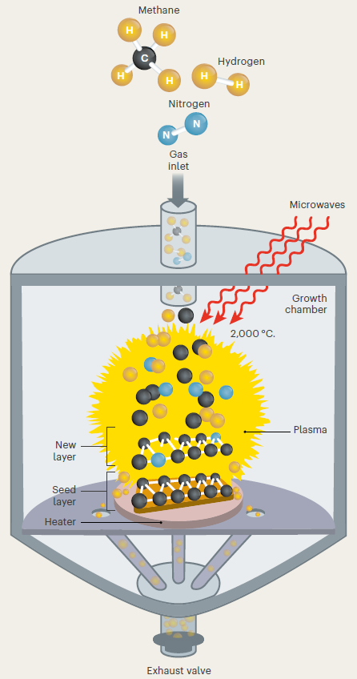
Growing Diamonds
1. Laying Down Layers
A mixture of methane, hydrogen and nitrogen gas is superheated (2000°C) using MW to form plasma.
Carbon atoms from methane as well as occasional nitrogen atom, settle out of plasma onto a heated seed layer.
Hydrogen acts as a catalyst and modulates the process.
N. Savage, Nature, Vol 591, doi.org/10.1038/d41586-021-00743-3

Slide 17
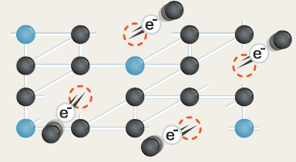
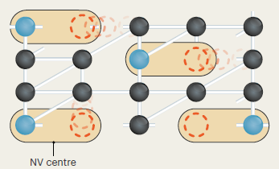
Growing Diamonds
2. Bombardment
The diamond film is hit with an high energy electron beam.
It kicks some carbon atoms out of the crystal lattice to create empty spaces called vacancies.
These vacancies are distributed randomly in the crystal lattice.
3. Annealing
Heating the diamond around 800° energizes the atoms causing the vacancies to move around.
Many vacancies settle next to nitrogen atoms and form NV centres.
N. Savage, Nature, Vol 591, doi.org/10.1038/d41586-021-00743-3

Slide 18
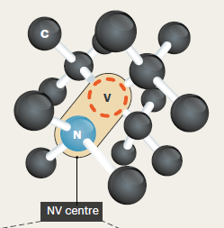
Growing Diamonds
4. Centres of Excellence
The nitrogen atoms, vacancy and the neighbouring carbon atoms together form an “artificial atom”.
This centre of excellence has its own quantum property known as spin.
Spin can be pictured as a set of magnets with North and South poles.
The arrangement of these magnets provides the spin state.
N. Savage, Nature, Vol 591, doi.org/10.1038/d41586-021-00743-3

Slide 19

Magnetic Sensing In Diamond
Experimental Setup
Diamond Sample:
Company: Sumitomo
Fabrication technique: HPHT
Nitrogen conc. : 100 ppm or 1.76 x 10¹⁵ cm⁻³
Size: 1.4 x 1.4 x 1 mm
Electron Irradiation:
Device: High energy e- accelerator
Energy: 10 MeV
Diamond was water cooled in a copper tube to avoid vacancy-carbon recombination above 150°C.
After that diamond was sealed in quartz tube and annealed at 850°C.
Helmholtz Coils:
A pair of Helmholtz coils was manufactured to provide static magnetic field to split the degenerate levels.
Filiang Mu et al., Sensor Review (2017) Volume 37, Number 4 | doi:10.1108/SR-09-2016-0163

Slide 20
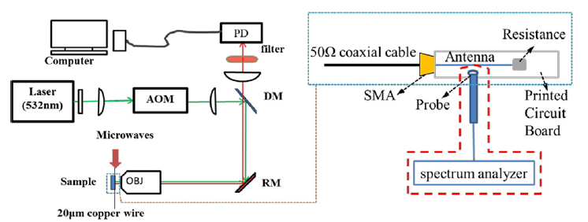
Magnetic Sensing In Diamond
Experimental Setup
Laser (532 nm): Optical pump for green light.
AOM (Acousto-Optic Modulator): Gating the laser to create pulses.
DM (Dichoric Mirror):
Reflects green light to sample.
Transmits red fluorescence to detector.
RM (Reflective Mirror): To steer the beam.
OBJ (Objective):
Focuses green laser onto the diamond sample.
Collects emitted red fluorescence.
Confocal ODMR setup
PD (Photodetector): Detects red photoluminescence signal.
Antenna: 20 um copper wire to deliver Microwaves.
PD (Photodetector): Detects red photoluminescence signal.
Long Pass Filter: Allows only red fluorescence to pass through it.
Filiang Mu et al., Sensor Review (2017) Volume 37, Number 4 | doi:10.1108/SR-09-2016-0163

Slide 21
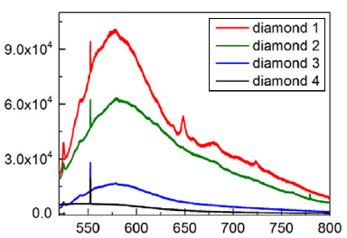
Spectral Analysis Of NV- Centre
Four different diamond samples were irradiated with electrons at an energy dose of 10 MeV for time :
Diamond 4 = 0 hour
Diamond 3 = 1 hour
Diamond 2 = 2 hour
Diamond 1 = 3 hour
Before Annealing
A stable sharp peak at 552 nm across all the samples as the overall carbon count in the diamond remains constant.
Some carbon atoms are physically knocked off from their normal positions due to electron irradiation.
So another peak at 524 nm indicates these carbon impurities between the diamond lattices.
Intensity (arb. Units)
Wavelength (nm)
Room Temperature fluorescence spectrum
of different diamond samples
Filiang Mu et al., Sensor Review (2017) Volume 37, Number 4 | doi:10.1108/SR-09-2016-0163

Slide 22
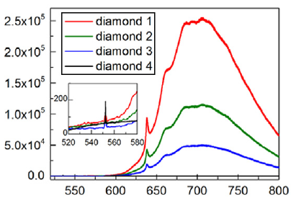
Spectral Analysis Of NV- Centre
After Annealing (850° C)
The spectra is dominated by NV⁻ Zero Phonon Lines (ZPLs) located at 638 nm.
Zero Phonon Line: Photon is emitted without losing any energy to surrounding diamond crystal lattice.
The peak has a line width of roughly 1.5 nm Full Width at Half Maximum (FWHM).
Peak increases progressively with longer electron irradiation time.
Higher dose period of electrons successfully increases the conc. of NV- centres in the diamond.
Intensity (arb. Units)
Wavelength (nm)
Fluorescence spectrum of
different diamond samples at 850° C
FWHM: Frequency or wavelength width where the intensity drops to 50%
Photon = Packet of light energy
Phonon = Packet of vibrational energy (heat or sound)
Diamond 4 = 0 hour
Diamond 3 = 1 hour
Diamond 2 = 2 hour
Diamond 1 = 3 hour
Filiang Mu et al., Sensor Review (2017) Volume 37, Number 4 | doi:10.1108/SR-09-2016-0163

Slide 23
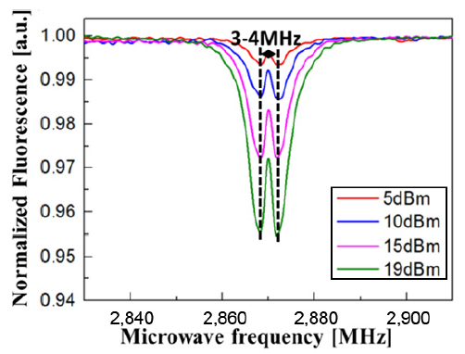
Electronic Spin Resonance
Results
Inputs:
The MW power was set from 5 to 19 dBm.
MW frequency was scanned from 2.765 GHz to 2.975 GHz in steps of 1 MHz.
Output: Normalized fluorescence.
Observations:
At zero MW frequency no change in fluorescence is observed.
The fluorescence has 2 dips at 2.868 GHz and 2.872 GHz due to mechanical strain.
Increasing the MW power increases the depth of dips as it drives more NV spins.
Increasing the MW power also broadens the BW of dip as the spin transition saturates.
The 3.5 MHz splitting remains constant as it is due to strain and is independent of MW power.
Relative change in fluorescence with variation of MW frequency and power
Filiang Mu et al., Sensor Review (2017) Volume 37, Number 4 | doi:10.1108/SR-09-2016-0163

Slide 24

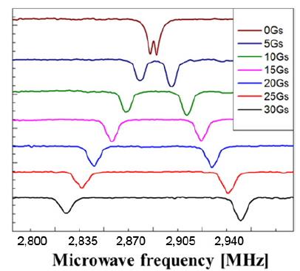
Electronic Spin Resonance
Results
Inputs:
The MW power was fixed at 19 dBm.
MW frequency was scanned from 2.8 GHz to 2.96 GHz.
Static MF was varied in steps of 5 G from 0 G to 30 G.
Output: Normalized fluorescence.
Observations:
Strain can be modelled as transverse EF.
As the MF increases, the two resonance dips split apart due to Zeeman effect.
The transition shifts higher in frequency.
The transition shifts lower in frequency.
Strain
Relative change in fluorescence with variation of MW frequency and static MF
Filiang Mu et al., Sensor Review (2017) Volume 37, Number 4 | doi:10.1108/SR-09-2016-0163

